Slide 1

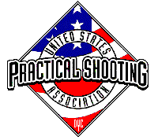
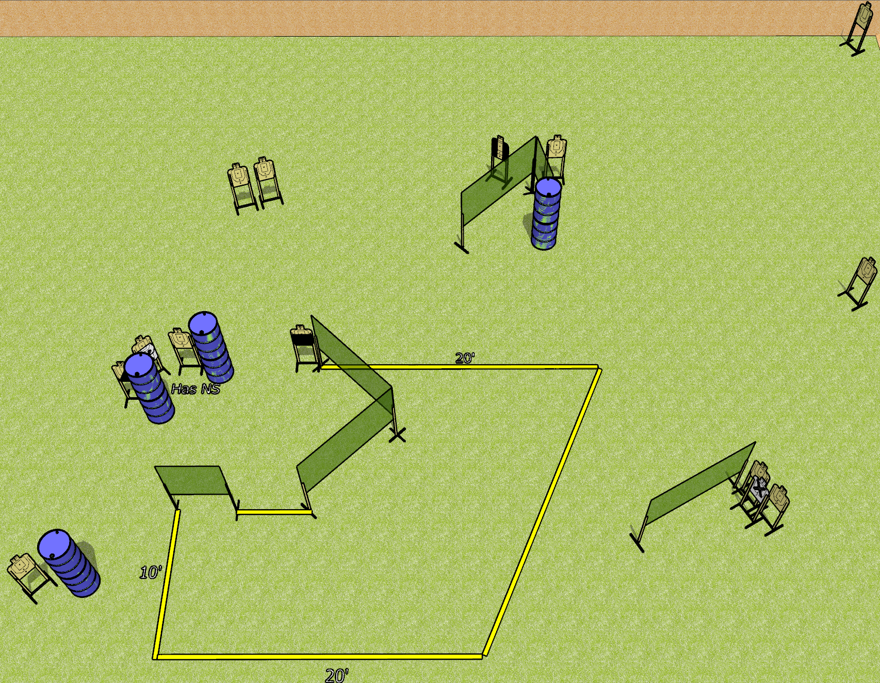
 | Dothan Gun Club – USPSA Match Throttle Control Course Designer : Drew Coleman
Round Count 26 rounds 13 USPSA targets
Equipment List 10 wall feet 2 medium fault lines 1 50%, 1 left diagonal, 1 tuxedo

Slide 2
Throttle Control
Written Stage Briefing
Throttle Control is a 26 round, 130 point, Comstock course of fire. There are 13 USPSA targets. The best 2 hits on paper will score, and steel must fall to score. The start signal is audible.
Handgun start position is inside the shooting area, wrists below belt. Handgun is loaded and holstered.
PCC start position is inside the shooting area, stock on belt. Loaded carbine is held with both hands, safety on.
On start signal, engage targets as they become available from within the shooting area.

